Slide 1
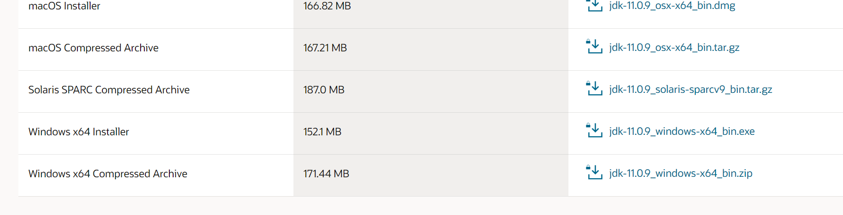
First download JDK11(the kit you need to create java programs )
Go to : https://www.oracle.com/java/technologies/javase-jdk11-downloads.html

Slide 2
How to download Eclipse to Windows

Slide 3
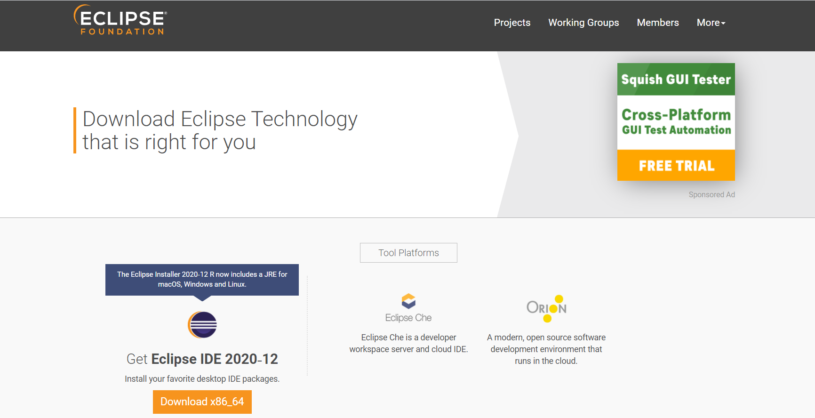
Go to : https://www.eclipse.org/downloads/

Slide 4
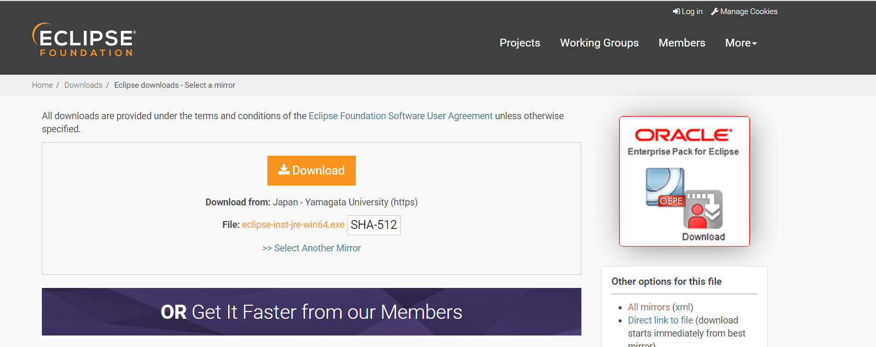

Slide 5
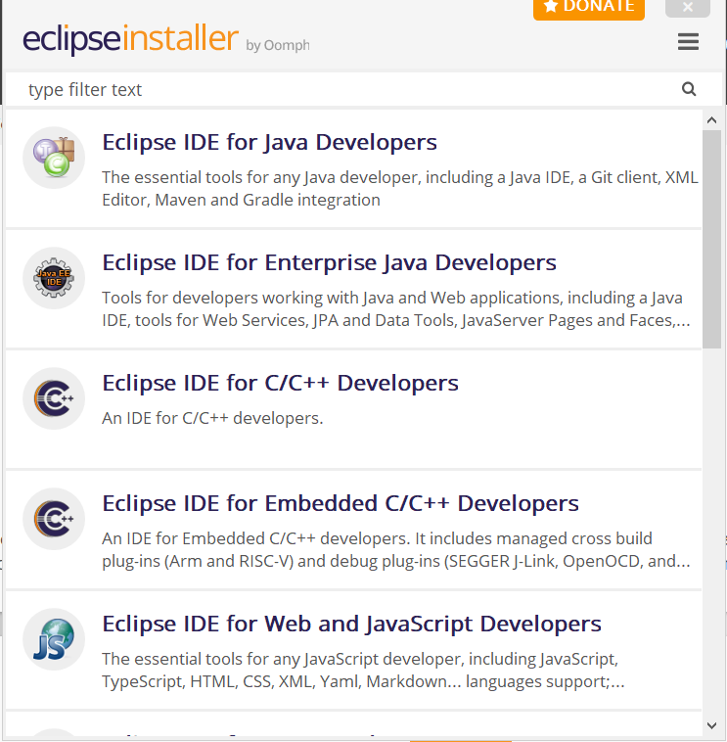

Slide 6
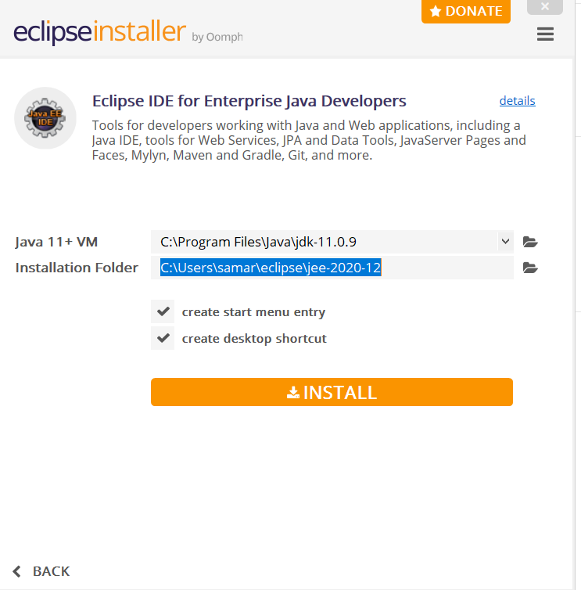

Slide 7
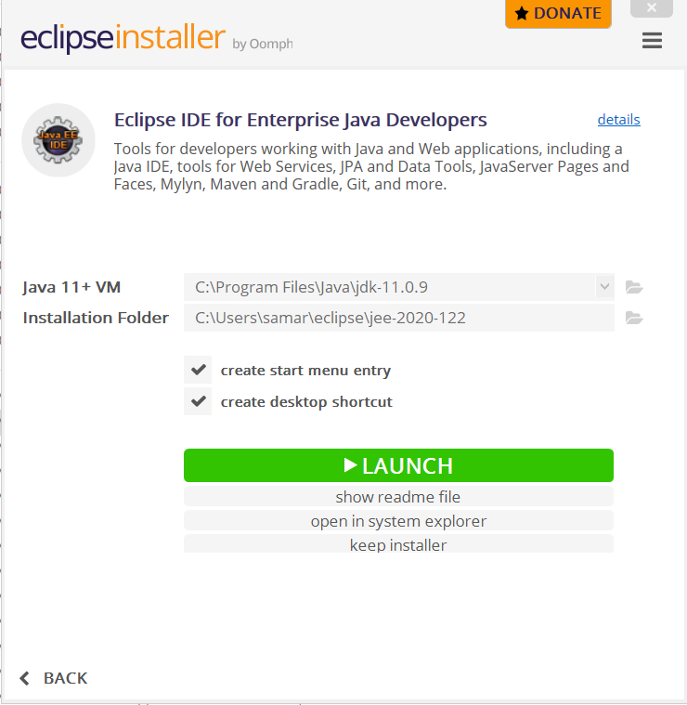

Slide 8
